Slide 1
DATA DRIVEN INSIGHTS FOR
DIGITAL MARKETING CAMPAIGN
Mini Project 7
Sangeetha Gunasekaran

Slide 2
AGENDA
01
ANALYTICAL OBSERVATION
02
DATA PREPARATION
03
KPIs & CHARTS CREATION
04
INSIGHTS FROM VISUALS
05
STRATEGIC RECOMMENDATION
06
DASHBOARD WALKTHROUGH

Slide 3
Dataset sourced from Google Analytics covering acquisition, engagement & audience behavior.
User & Traffic Acquisition tables reveal key channels driving website visits.
Landing Page data highlights pages generating the highest first-time user entry.
Events dataset tracks user interactions and engagement patterns.
Retention data shows how effectively the website retains returning users & attracts new users.
Audience & Demographics identify user segments by country, age, gender & interests.
ANALYTICAL OBSERVATION

Slide 4
DATA PREPARATION
MS Excel: Data was cleaned by removing extra spaces, correcting symbols, and standardizing values to ensure accurate analysis.
Changed the dataset to appropriate datatypes
Power BI: Created DAX measure for calculating
- ROI from Total Revenue & cost spent data
- Returning Users by subtracting new users data from …………..Total users
Notes:
ROI = (Total Revenue – cost spent)/cost spent

Slide 5
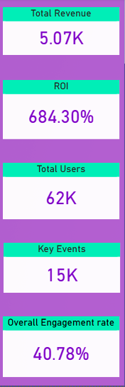
KEY PERFORMANCE INDICATORS
Total Revenue: The website generated $5.07K revenue from user activity.
ROI: Paid Marketing campaigns are highly profitable. Revenue generated is much higher than the marketing cost.
Total Users: The website has strong traffic volume.
Indicates good reach from marketing channels.
Key Events: A large number of important user interactions occurred. Shows strong user activity before conversion.
Overall Engagement Rate: Around 41% of users actively engage with the website.Engagement level is moderate but can be improved.

Slide 6
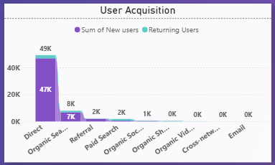
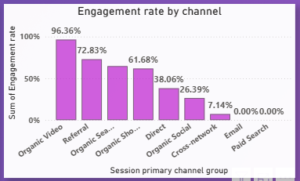
USER ACQUISITION
Direct channel brings the highest number of users, far more than other channels.
Organic Search is the second largest traffic source, while other channels contribute very little.
Has more new users than the returning ones
ENGAGEMENT RATE BY CHANNEL
Organic Video has the highest engagement rate, A higher proportion of users coming from Organic Video actively interact with the website (scrolling, clicking, viewing items), showing strong user interest.
Email and Paid Search show almost no engagement, indicating poor user interaction from these channels.

Slide 7
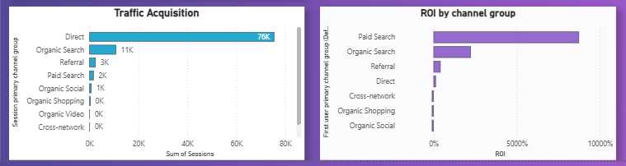
INSIGHTS FROM TRAFFIC ACQUISITION
INSIGHTS FROM ROI BY CHANNELS
Observation:
👉 Direct channel generates maximum sessions
Observation:
👉 Paid Search produces highest ROI
Most visits come from users who: Type website URL directly, Already know the brand
✅ Interpretation: The brand already has strong awareness. This can be due to ongoing promotional campaigns
Users acquired through ads: Convert better, Generate higher revenue, Deliver strong return compared to cost.
✅ Interpretation: Paid campaigns are highly efficient revenue drivers.

Slide 8
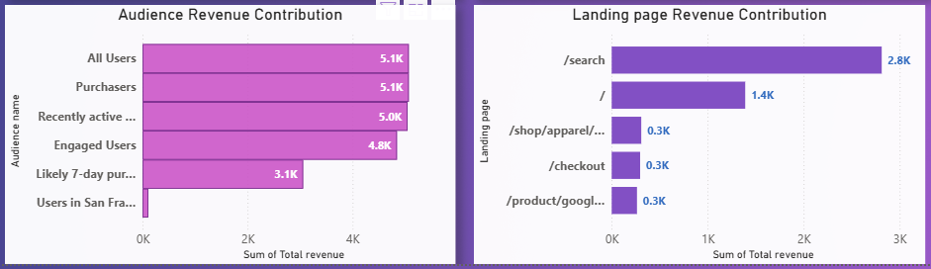
Purchasers and All Users generate nearly the entire revenue (~$5.1K), showing that a small purchasing segment drives most business value.
Engaged and Recently Active users also contribute significant revenue, indicating strong conversion potential among active audiences.
The /search landing page generates the highest revenue (~$2.8K), making it the most effective entry point for conversions. The homepage / is the second biggest revenue driver (~$1.4K), while other pages contribute comparatively minimal revenue.

Slide 9
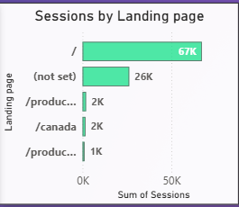
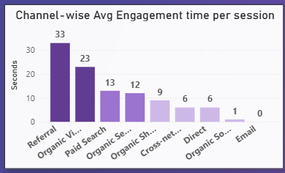
Homepage / drives the majority of sessions (~67K) – Most users enter the website through the homepage, making it the main traffic entry point.
(not set) page has high sessions (~26K) – This suggests possible tracking or tagging issues where the actual landing page was not recorded correctly.
Referral has the highest engagement time per session (33s) → Users from referral sources & Organic videos spend more time on the site, suggesting they stay longer & explore content more deeply
Notes:
Implication: Organic Video brings more users who engage, while Referral traffic brings users who stay longer and potentially explore more content.

Slide 10
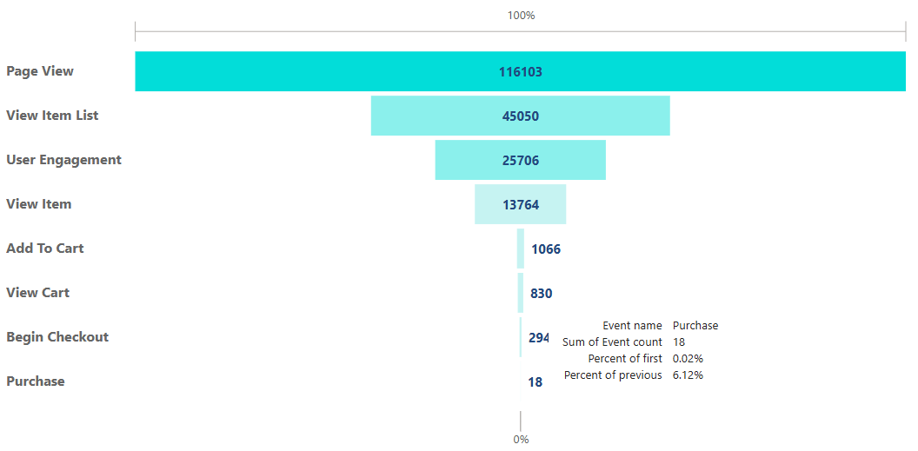
USER CONVERSION FUNNEL
Funnel chart used to show user drop off at each stage
Used Display Conversion rate label to show the percentage of drop outs happening in comparison to previous & 1st stage.
Huge drop-off from Page View (116K) to Purchase (18) – Many users visit the site but only a very small number complete the purchase, showing low final conversion.
Biggest loss occurs after View Item (13.7K) to Add to Cart (1K) – Only 7.5% users added items to cart– Many users view products but very few proceed to add items to the cart.

Slide 11
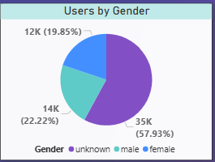
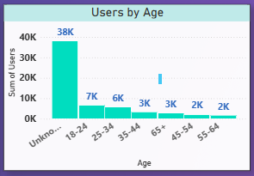
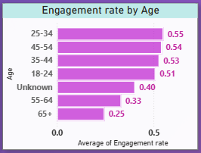
DEMOGRAPHIC DATA
Majority user group’s gender is not recognized. Otherwise, from the available date this website seems to have more male users than female
Majority user group’s age is not recognized. From available data this website seems to have more users between the age group 18 to 24, followed by 25 to 34. Other age groups are notably low performing
In terms of Engagement all the age group users between 18 to 54 have same engagement level. 55+ users seems to be very less engaged with the website.

Slide 12
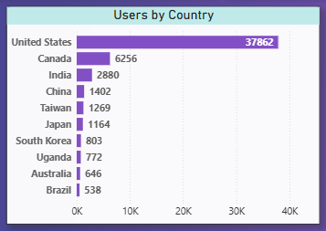
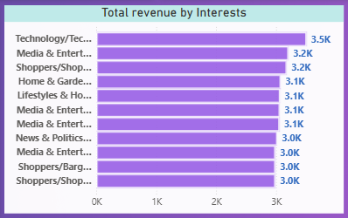
Most of the users of the website are from United states. The 2nd most used Country Canada yields only 1/6th of the traffic of US.
Therefore considering the potential US and Canada can be mainly focused
Users showed more interest in Technology & related fields therefore these areas have contributed to the Top revenue generation for the website

Slide 13

RECOMMENDATION
Optimize product pages for conversion – Improve product descriptions, images, and CTAs to convert more “View Item” users into “Add to Cart”.
Reduce checkout drop-offs – Simplify checkout steps and enable guest checkout to increase purchases.
Leverage high-engagement channels – Invest more in channels like Organic Video, Referral, and Organic Search that show higher engagement rates.
Improve homepage conversion – Since most sessions land on /, add stronger CTAs, featured products, and offers on the homepage.
Retarget interested users – Run remarketing campaigns for users who viewed items or added to cart but didn’t purchase.
Fix tracking issues – Investigate the (notset) landing page, Unknown gender and unknown age data to ensure accurate data collection and better analysis.

